Slide 1


I M P A C T R E P O R T
ANWOJUE HOPE FOUNDATION
JANUARY - DECEMBER, 2024

Slide 2
CONTENT TABLE
Welcome Address (AHF Executive Director
2024 impact report
Here comes 2025
We love feedbacks
Thanks for viewing
Anwojue Hope Foundation 2024

Slide 3
Welcome Address
Dear Esteemed Readers,
I extend a warm welcome to our virtual end-of-year board meeting. It is a pleasure to have you all join us today, despite the distance. Your unwavering commitment and guidance have been instrumental in our organization's progress throughout the year.
As we reflect on the past year, I am filled with pride and gratitude for the impactful work we have accomplished across over 8 local governments in Ogun State. Our projects have touched the lives of boys, girls, women, men, and the elderly, making a tangible difference in their communities. And now, we are honored to have been recognized with the award for Best Project of the Year by YALIOGUN.
Together, we have empowered individuals and encouraged sustainable development.
Anwojue Hope Foundation 2024

Slide 4
Welcome Address
We have witnessed the transformative power of our initiatives, and I am truly humbled to be part of such a dedicated team.
As we look ahead to 2025, I am filled with optimism and excitement. With your continued support and the unwavering dedication of our team, I am confident that we will achieve even greater heights. We are committed to expanding our reach, deepening our impact, and painting the communities with smile.
Thank you once again for your invaluable contributions. I look forward to a productive and insightful meeting.
Anwojue Hope Foundation 2024

Slide 5
2024 IMPACT REPORT
BY
AHF PROJECT MANAGER
Anwojue Hope Foundation 2024

Slide 6
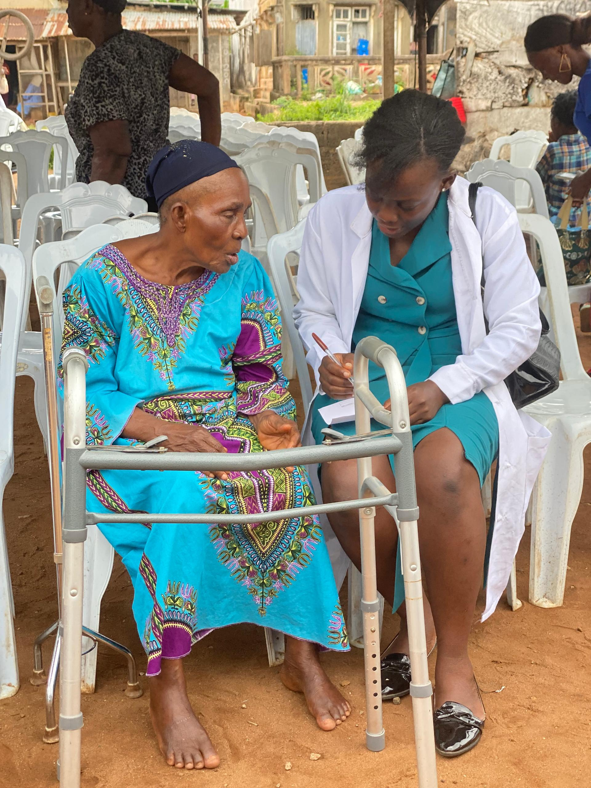
EXECUTIVE SUMMARY
AHF continued its dedicated efforts to bring joy and hope to the lives of the aged, widows, orphans, and other vulnerable groups. By leveraging the foundation's resources and the invaluable support of the Board of Directors, AHF concluded the year with a positive impact on the community.
Anwojue Hope Foundation continued its dedicated efforts to bring joy and hope to the lives of the aged, widows, orphans, and other vulnerable groups. By leveraging the foundation's resources and the invaluable support of the Board of Directors, AHF concluded the year with a positive impact on the community.
The focus is on the provision of resources to support the vulnerable groups through our health and food matters initiative, capacity building for in and out of school girls with our summer skills acquisition for adolescents,and to promote education among school girls and boy with our AHF Education initiative.
In 2024, AHF directly impacted the lives of 2,181 individuals through a variety of programs and initiatives.
Anwojue Hope Foundation 2024

Slide 7
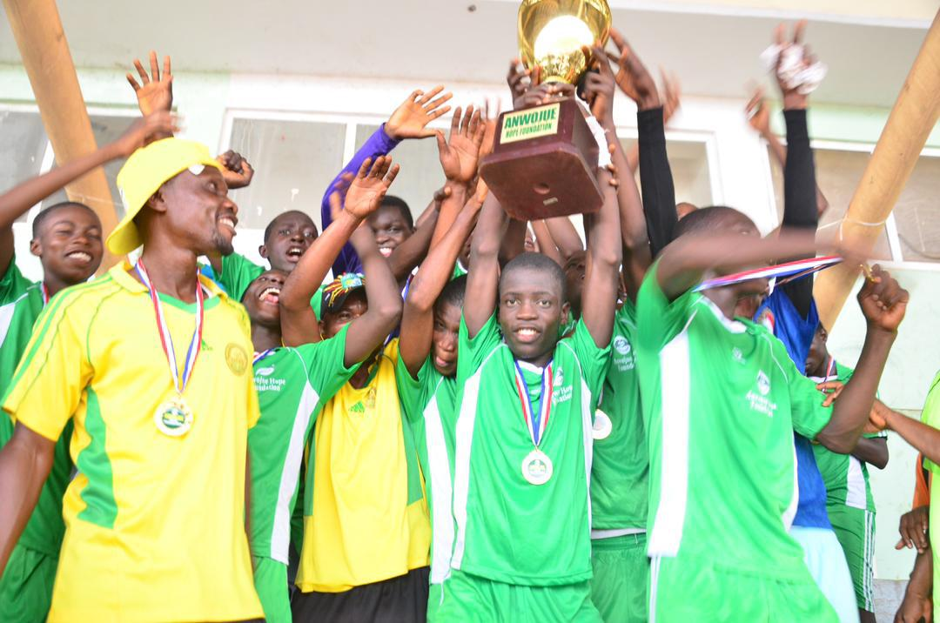
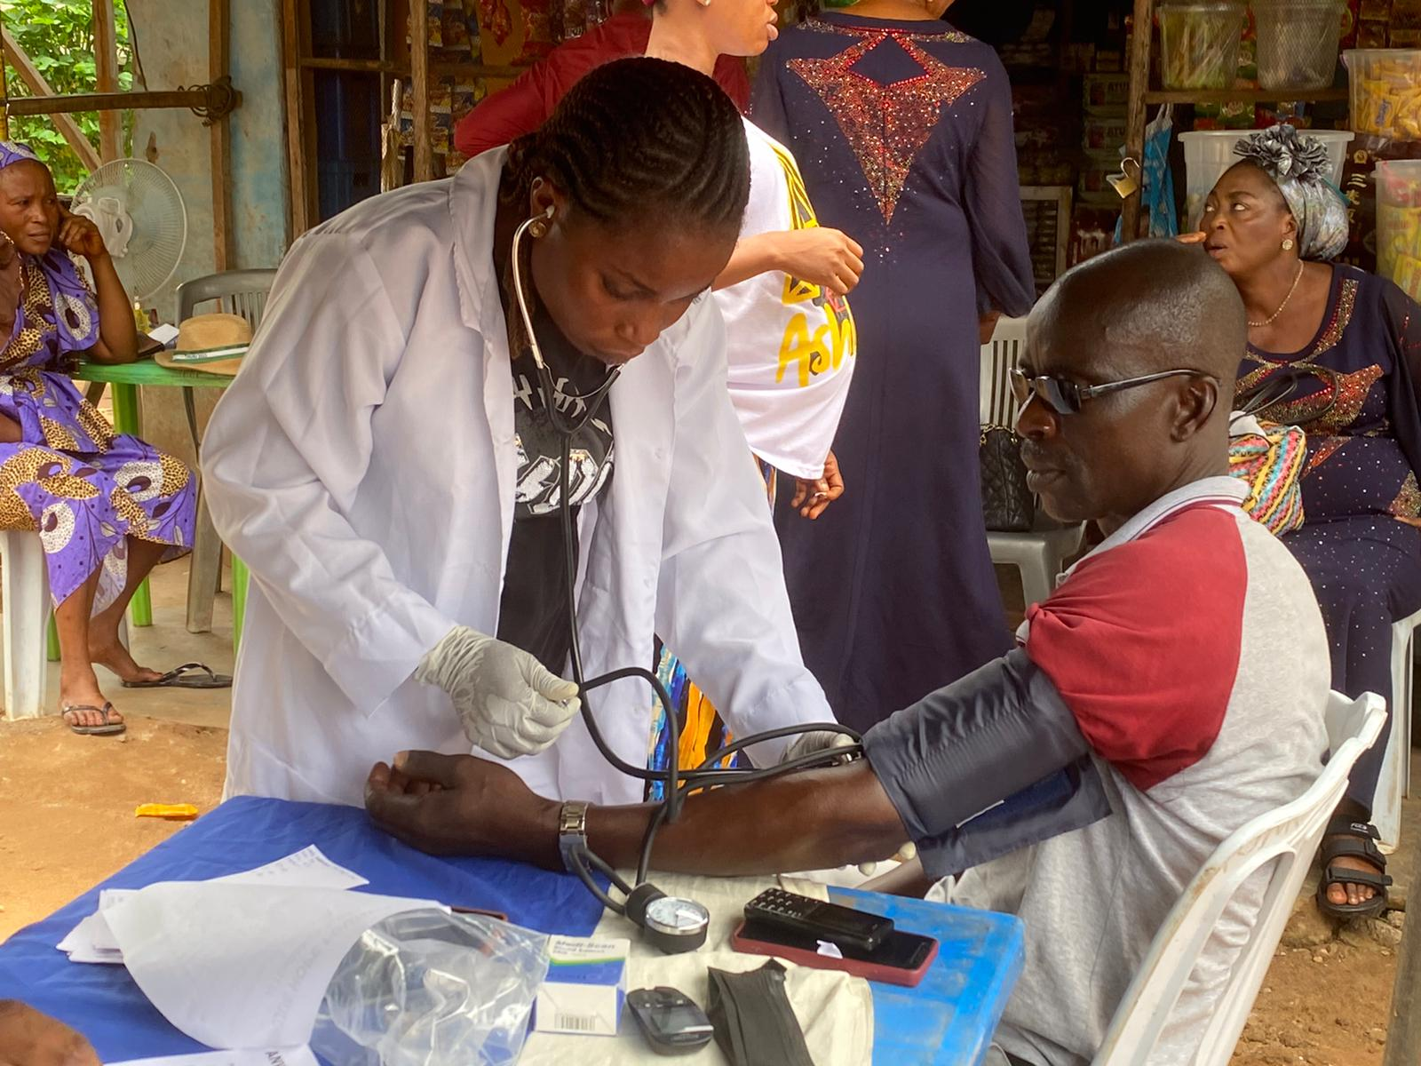
2024 PROJECT OUTLINE
AHF continued its dedicated efforts to bring joy and hope to the lives of the aged, widows, orphans, and other vulnerable groups. By leveraging the foundation's resources and the invaluable support of the Board of Directors, AHF concluded the year with a positive impact on the community.
Our primary focus is on empowering vulnerable groups through initiatives such as:
Health and Food Security: Provided free medical outreach and food support to elderly community members through the Health and Food Matters initiative.
Skills Development: AHF provided free summer skills training to 22 adolescent boys and girls, both in and out of school, to equip them for future success.
Education: Promoting education for both boys and girls through the AHF Education and sport competition Initiatives.
AHF STAR: Empowered adolescent girls through reproductive health education and provided sanitary pads to promote menstrual hygiene.
A significant achievement this year was the distribution of over 1100 sanitary pads to 7 schools in Abeokuta, Ogun State. This initiative directly addressed a major barrier to girls' education, reducing absenteeism.
Anwojue Hope Foundation 2024

Slide 8
IMPACTFUL REACH
AHF continued its dedicated efforts to bring joy and hope to the lives of the aged, widows, orphans, and other vulnerable groups. By leveraging the foundation's resources and the invaluable support of the Board of Directors, AHF concluded the year with a positive impact on the community.
1235 Girls
846 Boys
68
Women
32
Men
Anwojue Hope Foundation 2024

Slide 9
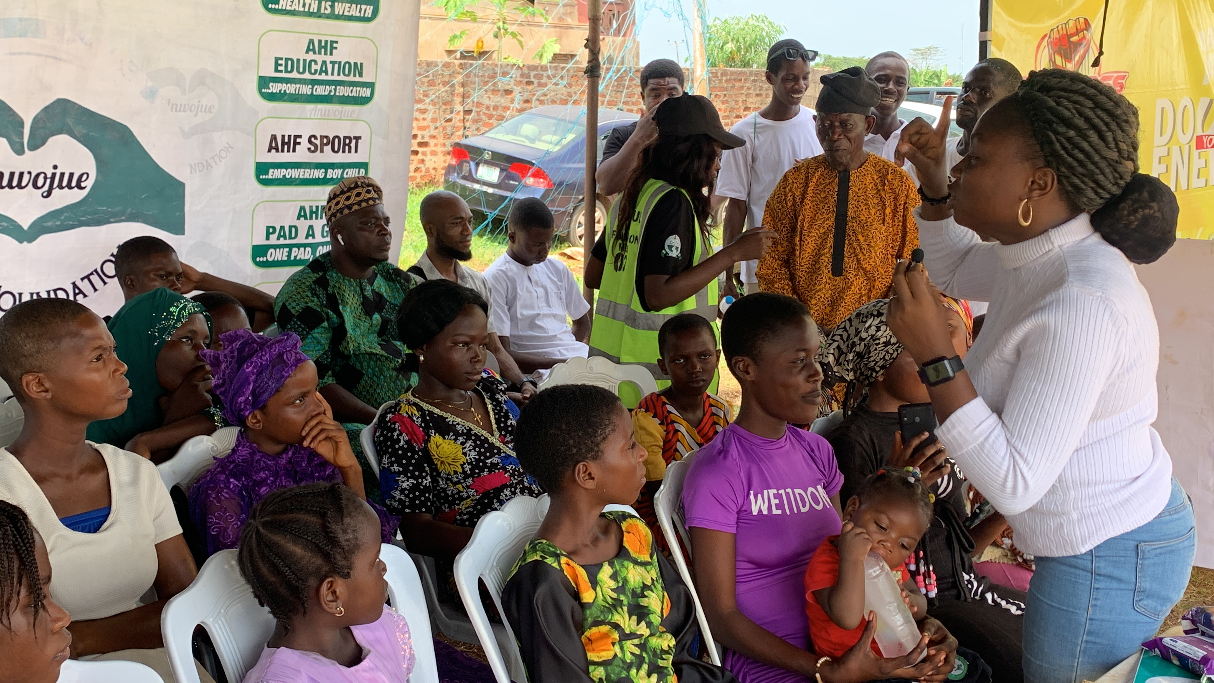
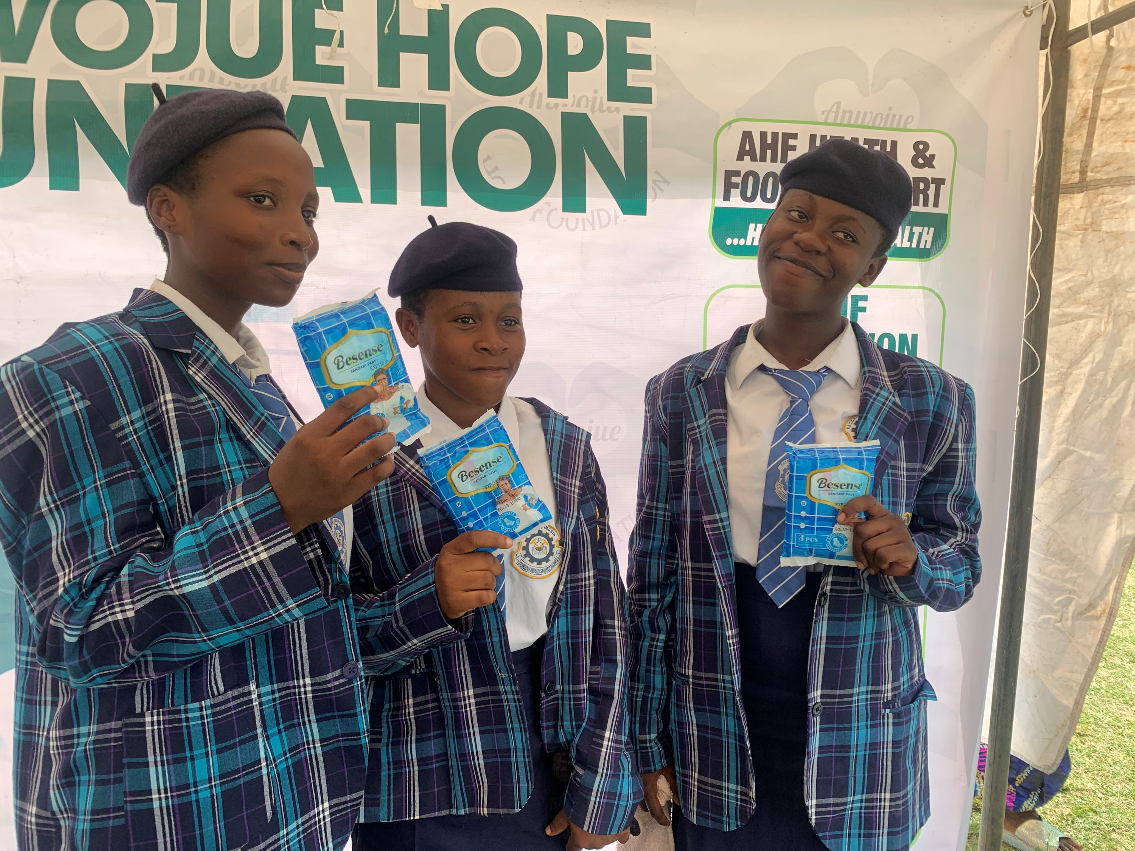
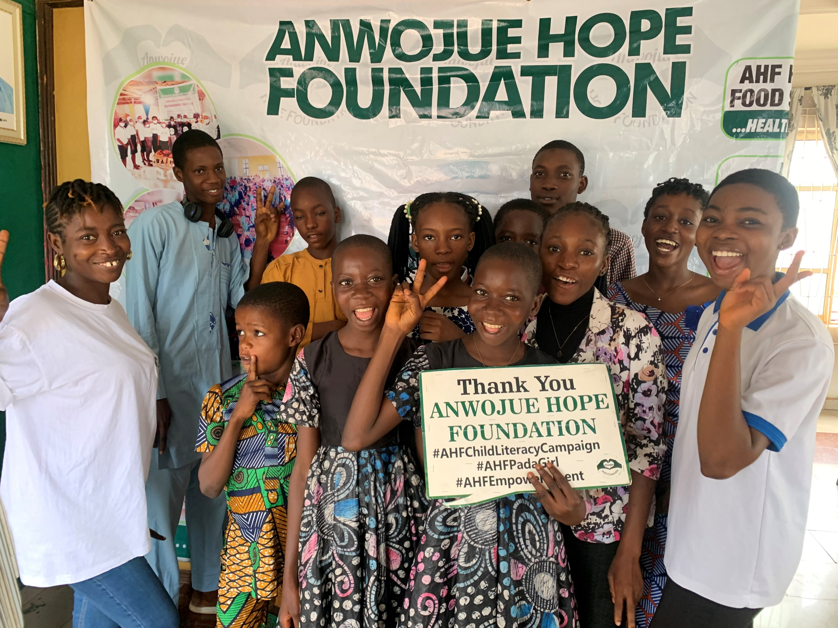
Beneficiaries of
AHF 2024
Adolescents
Primary school pupils
Out of school girls and boys
In School boys and girls
Elderly Men and women
Anwojue Hope Foundation 2024

Slide 10
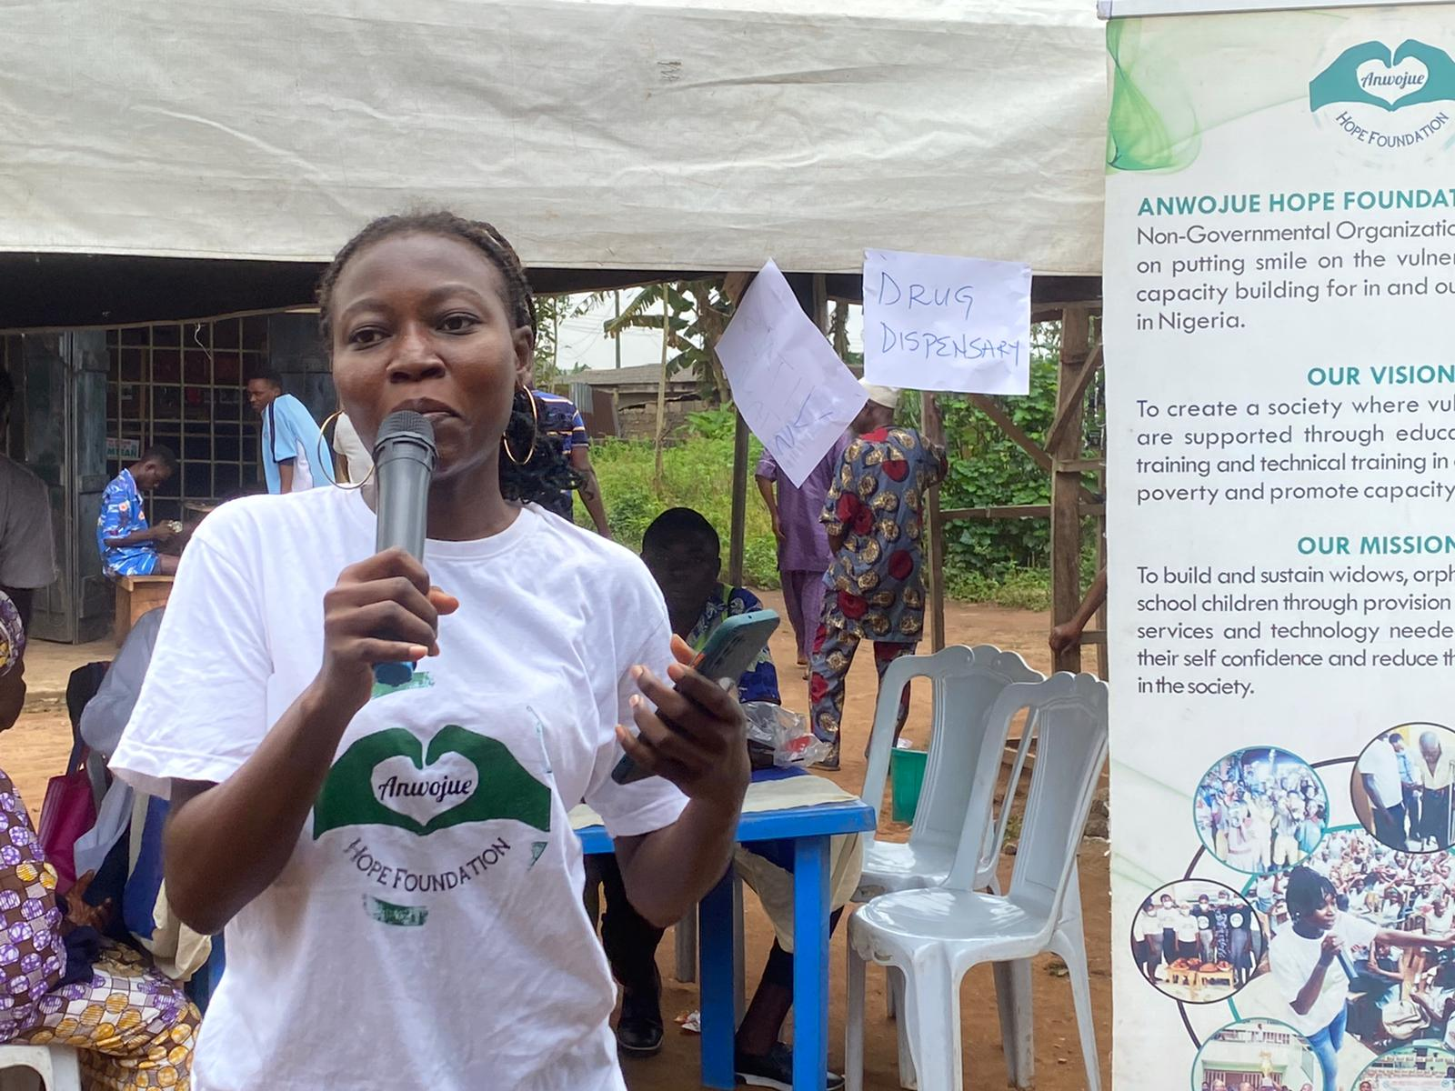
SPELLING BEE COMPETITION
CHILDREN’S DAY
DRUG ABUSE AWARENESS LEVERAGING ON FOOTBALL COMPETITION
MENSTRUAL HYGIENE DAY
10K PADS FOR GIRLS
HEALTH AND FOOD MATTERS SEASON 3
END OF THE YEAR PARTY
PROPOSED
2025
ACTIVITIES

Slide 11
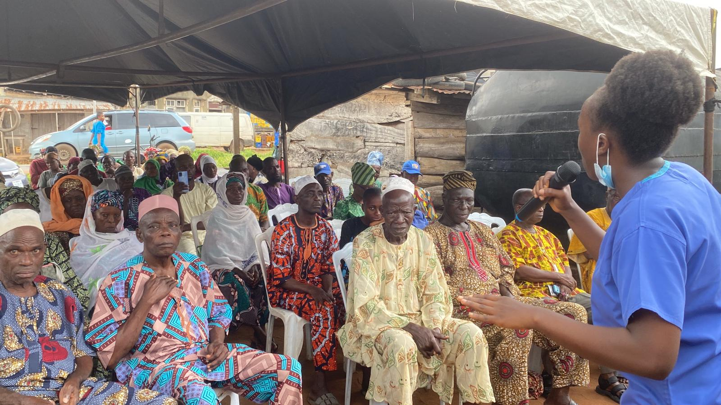
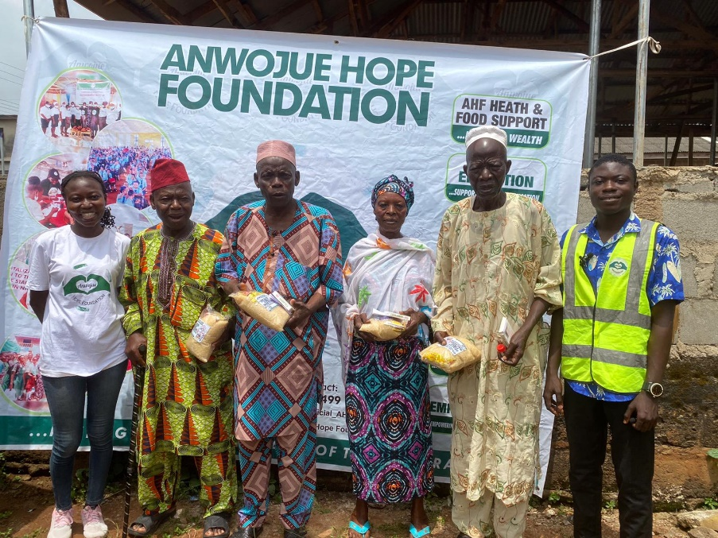
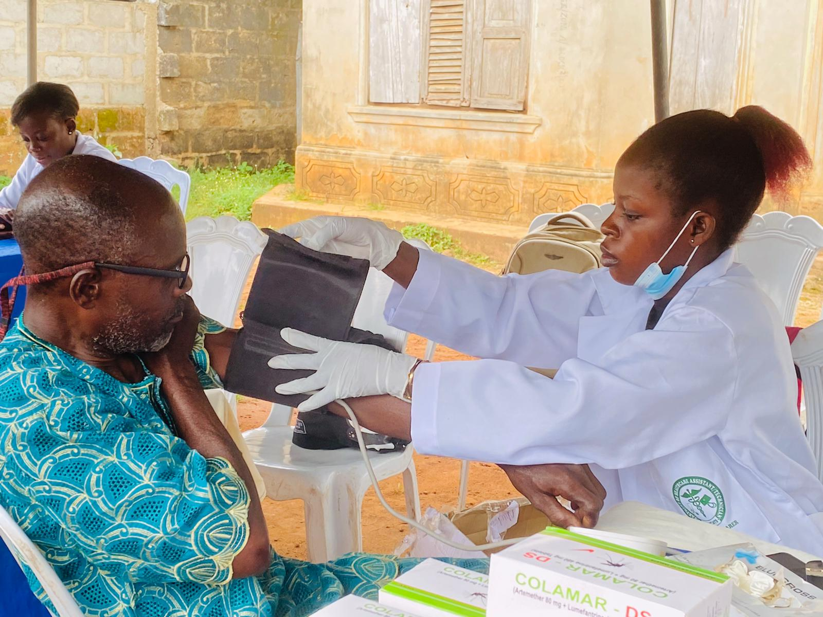
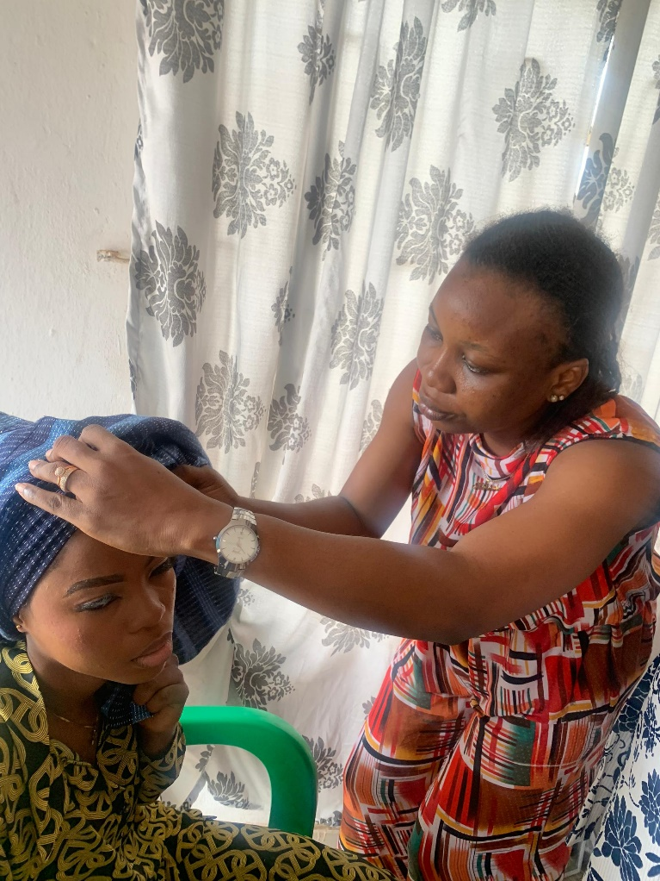

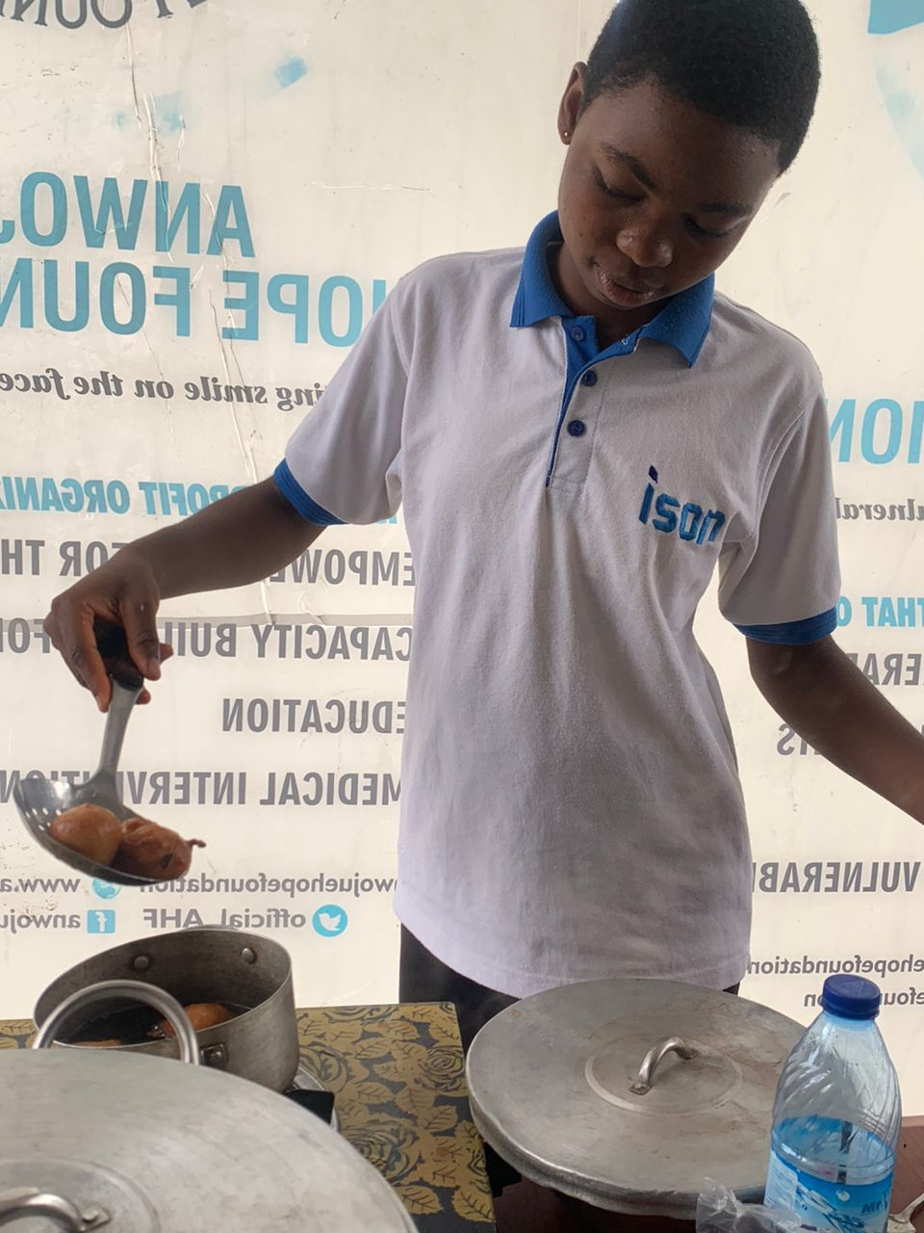
More project pictures

Slide 12
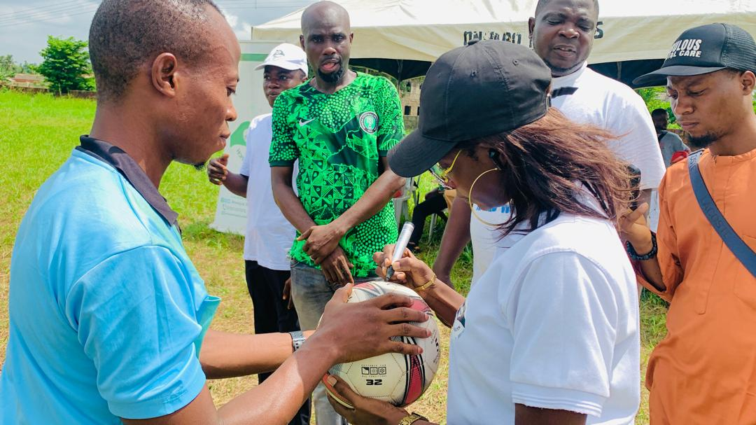
We would love to hear from you
Questions, comments and suggestions

Slide 13
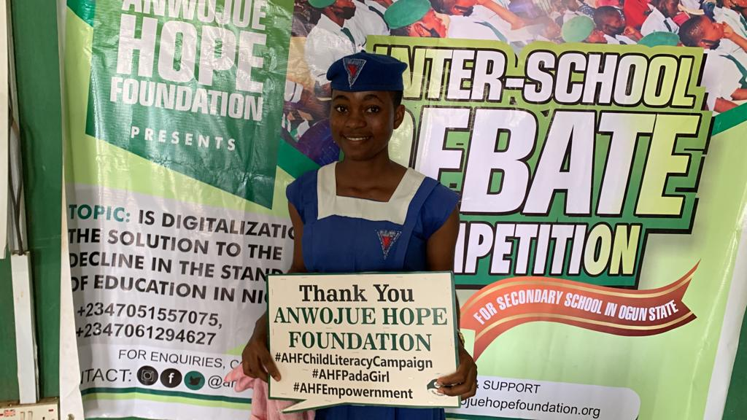
THANK YOU FOR VIEWING
www.anwojuehopefoundation.org
+2347051557075

