Slide 1

Anwojue
Hope
Foundation
Welcome you to the
Second Quarter Review Meeting
Compiled by Busayo Soyebo-Eniade

Slide 2

AHF MEETING AGENDA
Opening Prayer
Opening Remarks
Business of the Day
  Presentation of the second quarter report
  Presentation of the third quarter activities/ budget
  Discussion on the presentations
AOB
Vote of thanks
Motion for Adjournment
Closing Prayer

Slide 3
Opening Remarks by the Board Chairman US branch
Welcome
It is my great pleasure to welcome you to the second quarter meeting of Anwojue Hope Foundation here on Zoom. We are very grateful for an awesome 2021 amid crisis and economic instability; the organization is always coming through with outstanding outcomes. A big thank you goes to everyone that contributed towards the success of our Project manager’s wedding.
I commend the presence of everyone here in spite of our busy schedule. You are all welcome once again. I would like to appreciate the effort of the entire team that put this together, let us keep up the work.
I would like to refer us to the some of our initiatives in the second quarter of the year: 700 girls have been reached through our PAD A GIRL projects in less than 4 months, the organization commemorated Menstrual Hygiene Day, Launch our own instructional material to teach both in and out of school girls the importance of menstrual hygiene in collaboration with Ogun corpers to reach out to girls through PAD A GIRL activity. The organization also had her first webinar, which was used to commemorate International Youth Day 2021.

Slide 4
I will not fail to commend the entire team that put our website together, that is a huge achievement for us. I cannot but to appreciate the effort of everyone that has made all these achievements possible.
All these obvious progress would not have been possible without the input of everyone of us. Thanks for being part of this great foundation with a great vision. It will be highly encouraging if we can make it our responsibility to give our support in terms of moral and financial in other to achieve this great vision.
Before coming to a close of this remarks, I see a great AHF, I enjoin us all to be part of this greatness.
I sincerely hope you will enjoy today’s meeting.
Thank you for your participation.

Slide 5
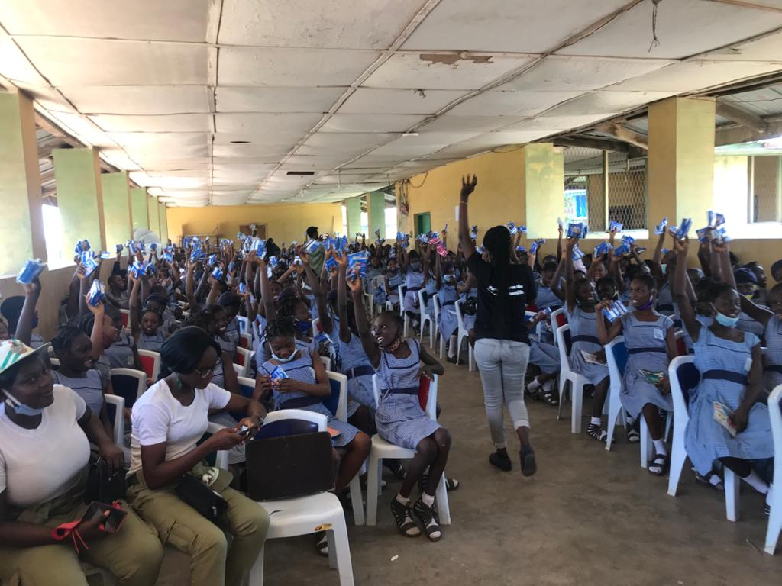
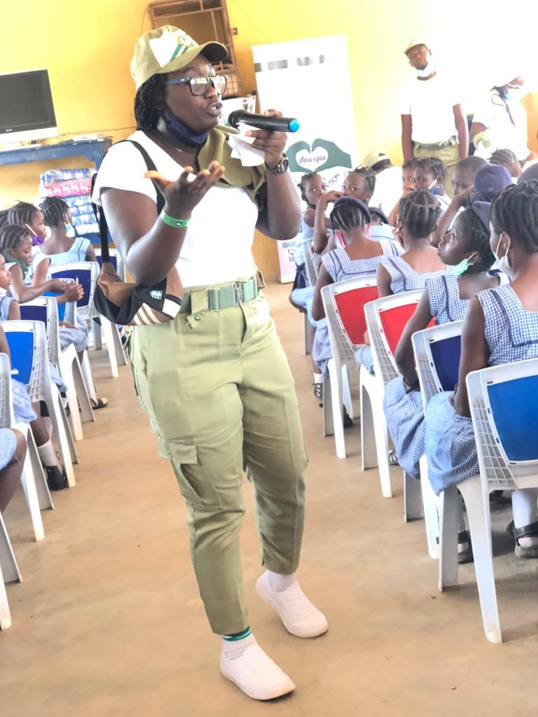
Presentation of the second quarter report
By the Project Manager
Busayo Soyebo-Eniade

Slide 6
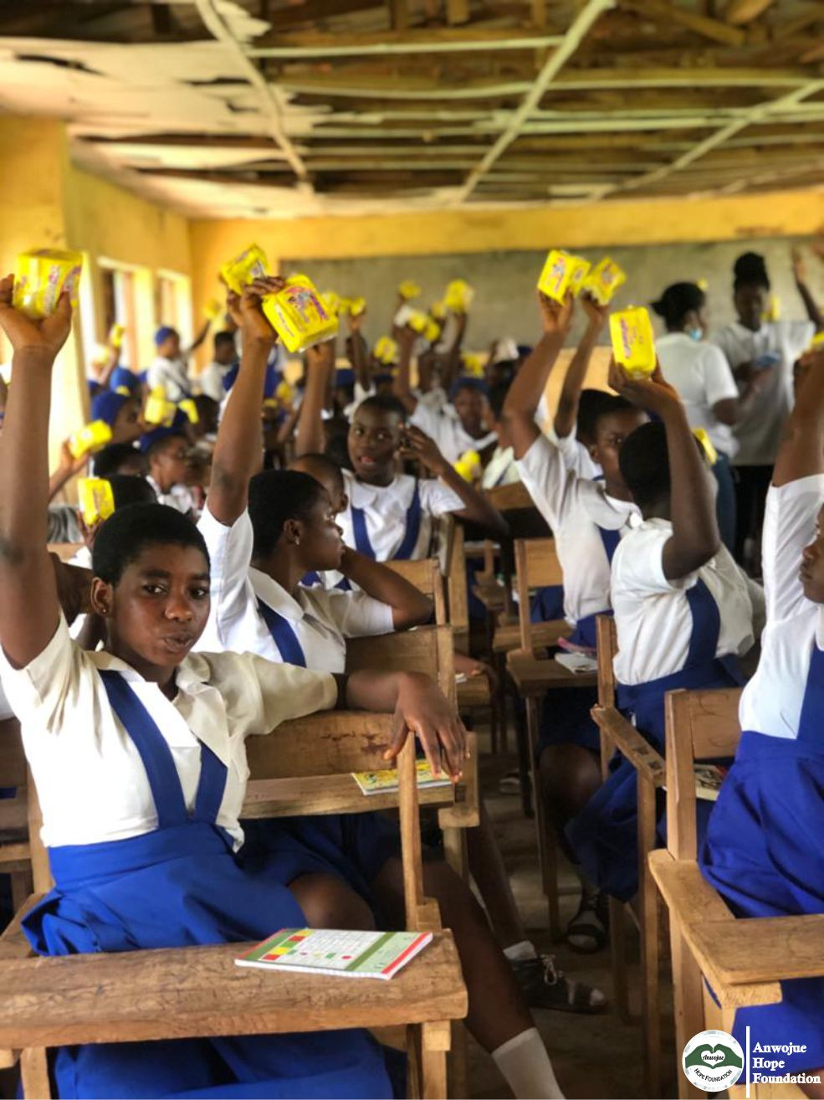
May Activity (MHD 2021)
The second quarter started in an awesome way as the organization participated in 2021 Menstrual Hygiene Day with 7 days social media engagement on Menstrual hygiene from 22nd – 28th May 2021. This initiative also enabled us to come up with our own flip chart on Menstrual hygiene as an instructional material for both in and out of school girls. On 28th of May, AHF team stormed Owode Grammer School at Obafemi Owode. Where we reached out to 215 girls. They were sensitized on importance of Menstrual hygiene and also each one of them was entitled to a pack of sanitary pad.

Slide 7
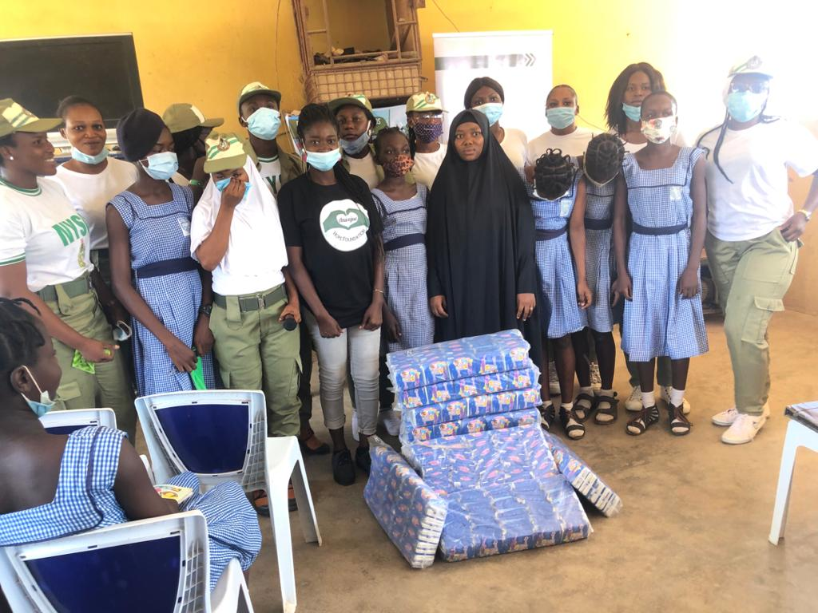
Pad A Girl Activity
(Ogun corpers)
May 31, the organization received a request for partnership from Abeokuta South youth corp members to provide support of 400 sanitary pad for 400 girls. The organization did not hesitate since its an already made platform to reach more.
400 girls were reached with the right information on menstrual hygiene and everyone went home with a pack of sanitary pad from the organization. Gifts were also given to outstanding students in the session. After the activity, we also got an appreciation letter from the corp members for an outstanding support during their program.

Slide 8
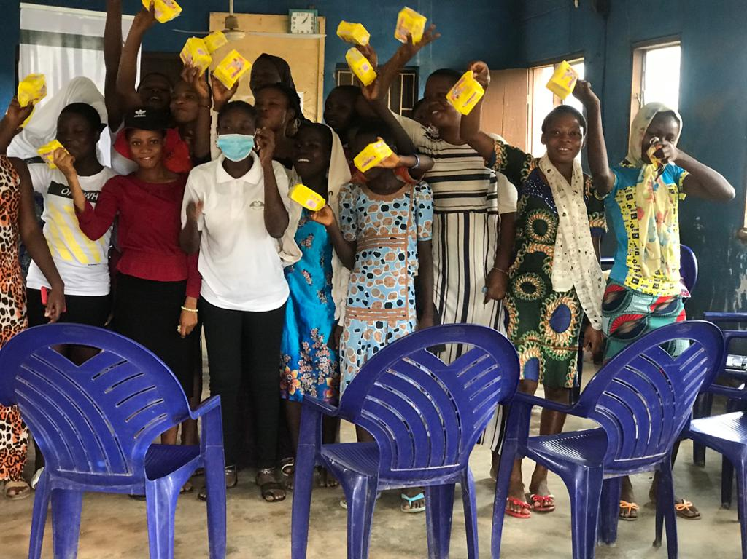

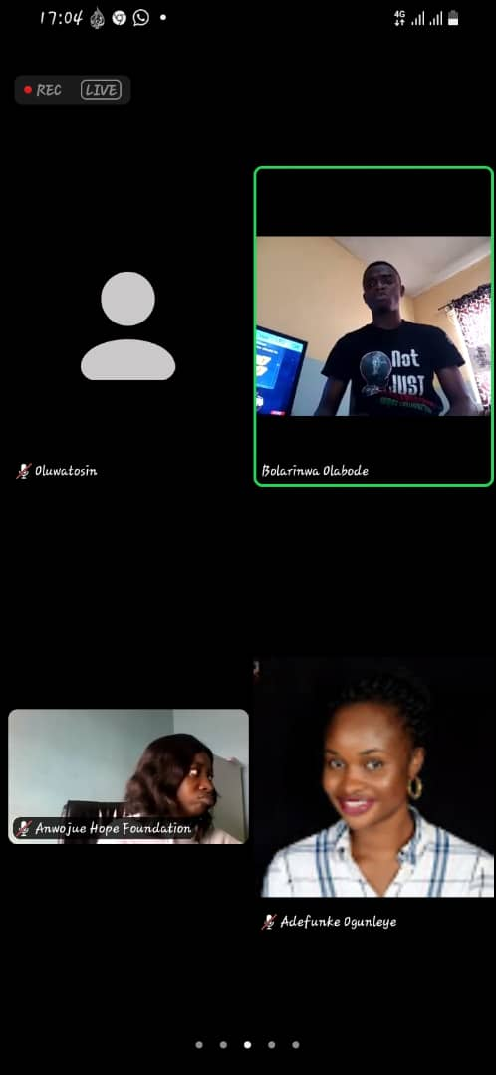
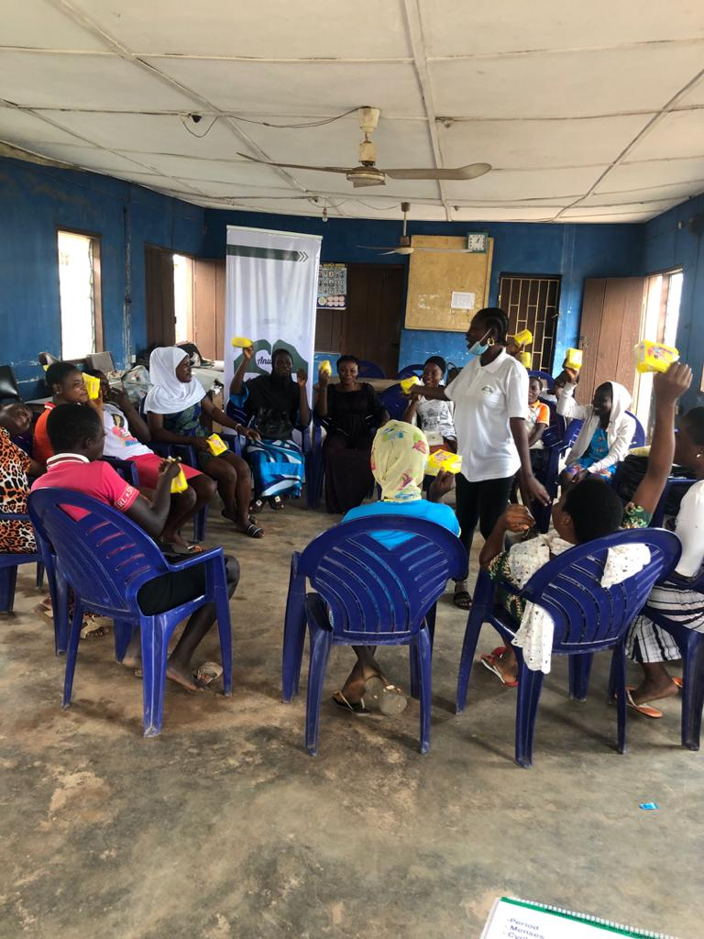


Other activities
The Foundation has reached 700 people directly in the second quarter and with our recent webinar and radio program we are still recording viewers as part of our reached audience.

Slide 10

Presentation
Of 3rd quarter activities & Budget

Slide 11

What do we do at AHF
Capacity building for both boys and girls in secondary school; Teaching them how to deal with peer pressure
Purchase of two mattresses monthly for the third quarter
Commemoration of International girl child day in Obafemi Owode Local Government.
Providing crouches to anyone with walking challenged
Empowerment program
End of the year party at Daniel Akintonde School
The organization remain focused on her aim to make life better for the vulnerable by bringing smiles to their faces. Who are the vulnerable group? How do we achieve this goal?

Slide 12

THANKS FOR VIEWING

